Slide 1


Slide 2
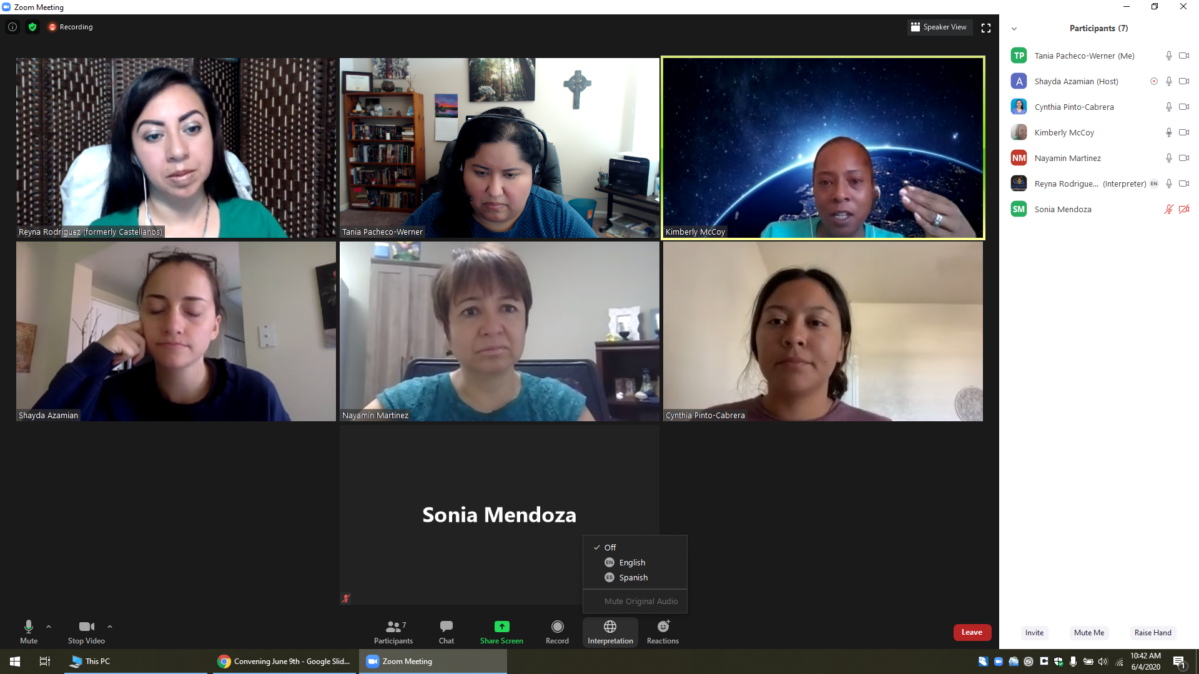
Welcome, Instructions for Zoom
Bienvenidos, Instrucciones para Zoom
Select the World Icon, Then Pick Your Prefered Language
Selecciona el Icono de Mundo, Elije Tu Idioma Preferido
The meeting will have simultaneous interpreting, so you are welcome to comment in your native language.
La junta será interpretada simultáneamente, así que le invitamos a que haga comentarios en su lenguaje nativo.
Tech support:
Para Apoyo Técnico:

Slide 3
AGENDA
Group Norms/Outcomes
Grounding Activity
Review of issues
Timeline review
Breakout Groups into Issue Caucuses (1 hr)
Come back together and share a quick summary from each issue caucus group
What to expect next
Homework
Notes:
Mike 2 min

Slide 4

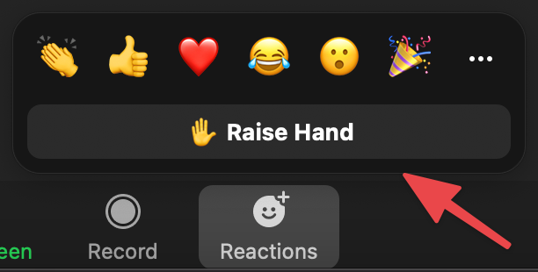
Let’s review our Norms...
1. Be open to new ideas
2. Listen to each speaker
3. Make equal time for all to share
4. In person meeting: Please keep your phone on silent, and if you
need to answer the phone, please excuse yourself from the room
5. During a virtual meeting we encourage you to have the camera on
to be fully engaged, keep your audio on mute
6. Treat others the way you would like to be treated
7. Use the hand icon if you have a question or comment, or put it in
the chat.
8. Facilitator permission to interrupt

Slide 5

OUTCOME FOR ISSUE CAUCUS BREAKOUT GROUPS
At the end of our Issue Caucus Meeting tonight, we will:
Agree on a shared understanding of the issue area (shared definition)
Share out your own lived experience with the issue
Agree on an additional meeting time for our Issue Caucus
If possible, determine what additional research is needed for our issue area
If possible, begin to draft our key questions for leaders in our issue area
Notes:
*Residents do not need to fully identify the systems and policies by the end of the meeting. Rather they should leave with the goal in doing research and sharing what they have found in the next meeting.
If a resident has already been conducting research, they are welcome to share it with their caucus group → deeper questions and further investigation
Do you feel like your voice was heard in this area?
Does this feel like an accurate representation of the issue, to you?
Do you feel like we need to add anything to this description?
Grounding Question: Who are you doing this work for?

Slide 6
Grounding Question and Reflection
Ho
As we refine the issue in our caucuses, let us be guided by some thoughts from adrienne maree brown:
In this space, set your intentions for “how you want to be, how your children’s children will feel, what the relationships will look like, how power will be shared, how governance will work, how justice will play out.”
Grounding Question: Who are you doing this work for?
Reflect.
Write your answer in the chat.
Share out.
Notes:
Facilitator: Matt, he/him/his
Note: After collecting names and answers in the chat, I will create a quick wordle to better visualize the responses and share the screen. Only if there is time to share that. https://www.flippity.net/WordCloud.htm
“The horizon we can see is not the end of the journey, it’s just the outer limit of our vision.”
Visualize our work here today if we were completely successful. What changes because of our work? What becomes more possible? What is no longer allowed? How does it feel in that world? (Holding Change, p188)
Facilitation thoughts:
Give members a chance to write individually or draw something or write a word
Have 1-3 people share?
Think about learning styles (large group vs. individual vs. small group

Slide 7








BREAKOUT GROUPS INTO ISSUE CAUCUSES
Mental Health
Affordable Housing in healthy communities with access to public services &
infrastructure
Safe and Inclusive schools for all
Childcare and workers rights for economic opportunities for families
Schools as a community for all
Support for children with disabilities and their families
High quality and affordable childcare
Workers rights & economic opportunities for families
Healthy Communities
Housing
Access to adequate public services & infrastructure
Digital Literacy & Access to Technology
Academic Success
Facilitator: Heidi
Core Team Members supporting: Destani Gerbrandt, Ysabelle Rosales, Bernardina Galindo, Amanda Sciacca
Facilitator: Pen
Core Members supporting: Diana Castaneda, Nhoua Yang, and Benita Vasquez
Facilitator: Mike
Core Team Members supporting: Juana Iris, Priscilla Herrera
Facilitator: Ofelia (CSN)
Core Team Members supporting: Cynthia Estrada, Stephanie Ocampo

Slide 8

Residents Council Timeline (Jan 2022-May 2022)
March 15th
Review and select questions for the discussion with Leaders
Feb 15th
Create a shared definition of each issue
Apr 19th
Internal discussions after ther exchange meeting
Issue Caucus Group Meetings: scheduling will be different for each group
Begin question development
End of Term Celebration (TBD)
2022
End of Year 1
Jan
Feb
Mar
Apr
May
Jan 25th
Build specifics for issue areas and begin research
May 2nd
Joint deliberative meeting with Leaders and align on one decision; Other groups have identified focus for Year 2
March 21-31
Meeting for question exchange and initial discussions with Leaders
Notes:
-Schedule at least 2 meetings with Issue Caucus group to develop questions so we can refine them together on March 15th

Slide 9
Things to think about…
Your lived experience with the issues being discussed
“My child” AND “All children in Fresno County”
Level of systems: Neighborhood, City, County, Region, State, or National
Hearing perspectives from people who are different than you

Slide 10

BREAKOUT TIME
1 HOUR

Slide 11

Share a quick report from your Issue Caucus

Slide 12


What to Expect Next
A summary of notes from your issue caucus will be forwarded to you and your Anchors
Meetings with your Issue Caucus group before March 15th to develop questions

Slide 13
Homework
Ho
Reflect on what was shared within your Issue Caucus group:
What are questions you may have from the experiences that were shared in your group?
I.e. “Why does the service/program have strict requirements? …”
How does your questions relate to systems?
Level of systems: Neighborhood, City, County, Region, State, or National
*This will prepare you as we share questions in our next issue caucus group meetings.

Slide 14

Next Residents Council Meeting
Residents Council Meeting #2
Tuesday, March 15th from 5:30pm-7pm

